Slide 1


SUTT Training Package
Train your laparoscopic stitching & knotting skills
Version 2018-07

Slide 2
Overview of
Package Contents

Slide 3
Box contents
Overview of Contents
SUTT Foam Base
10 SUTT1 Pads for Training
10 SUTT2 Pads for Training
Pins to attach the SUTT Paper to the SUTT Foam Base
Stopwatch to record the time of the exercises

Slide 4
Online Scoring Platform

Slide 5
Functionality
Online Scoring Platform
The SUTT Training Package is to be used together with the Online Scoring Platform, it allows you to:
  manage mentees participating in your sessions
  submit LASTT, SUTT and HYSTT training results
  see how your mentees relate to the benchmark group and see the group distribution
  validate when the minimal requirement for entry in the operating room is met
  issue branded reports for internal use
A license for the OSP can be acquired by going to
www.id-trust-medical.eu

Slide 6

Online Scoring Platform

Slide 7
SUTT Exercises

Slide 8
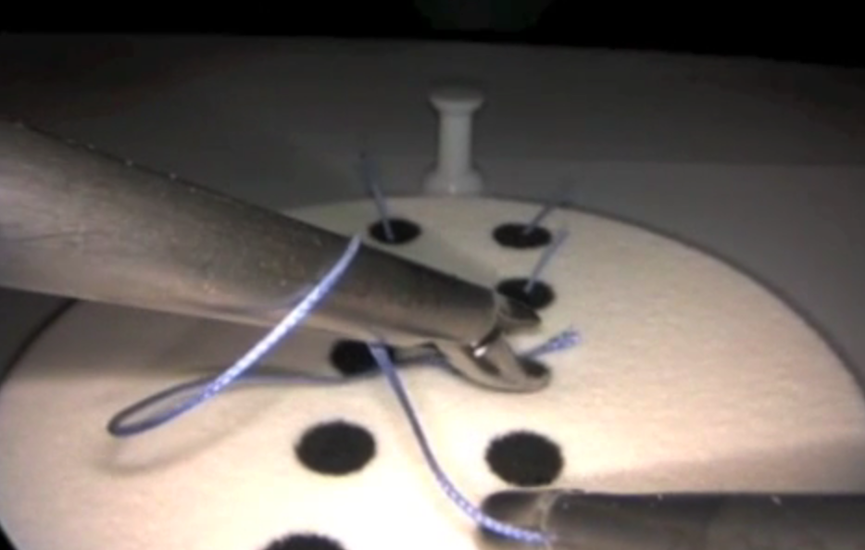
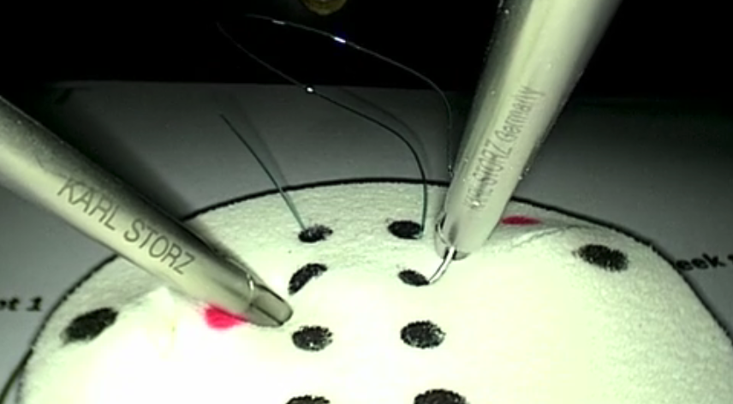
About SUTT
SUTT Exercises
Measure the ability of fine and complex motor skills by performing:
  correct stitches
  intra-corporeal knot

Slide 9
Conditions
SUTT Exercises
Exercises are done in pairs, where one mentee performs the exercise and the other assists
All exercise runs are carried out and timed simultaneously under instruction of the head mentor
Scoring happens on the basis of time to correctly perform the exercise and quality: precision through the dots, correct pathway of the stitch, knot quality, absence of trauma

Slide 10
SUTT1 Exercise

Slide 11
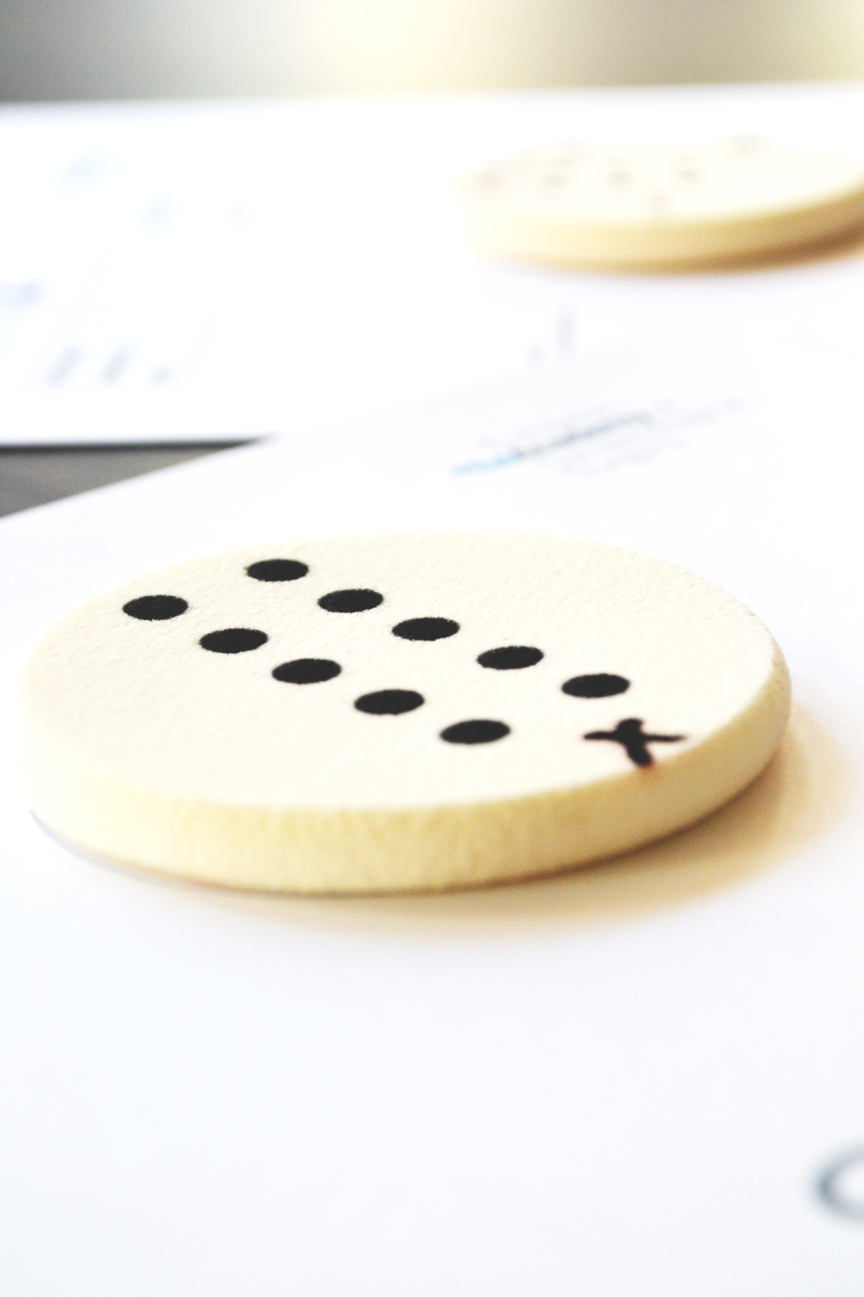
Aim
SUTT1 Exercise
Measure the ability of fine and complex psychomotor skills by performing stitches using correct needle handling and intra-corporeal knot tying

Slide 12
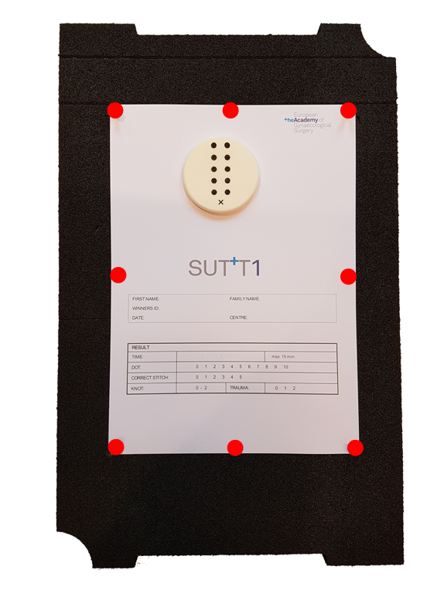
Setup
SUTT1 Exercise
Align the top of the SUTT1 paper with the second line from the top on the SUTT Foam Base
Securely attach the paper with 8 pins to the SUTT Foam Base
Place the SUTT Foam Base inside the Pelvic Trainer

Slide 13
Port Position
SUTT1 Exercise
6
CAMERA
is introduced in the frontal middle port (position 1)
NEEDLE HOLDERS
frontal lateral ports (position 2A & 2B)
TROCARS
are optional
Correct orientation of the pelvic trainer: port 1-3 are closer together than 3-6
5A
5B
4A
4B
3
2A
NEEDLE
HOLDER
2B
NEEDLE
HOLDER
1
CAMERA
Participant

Slide 14
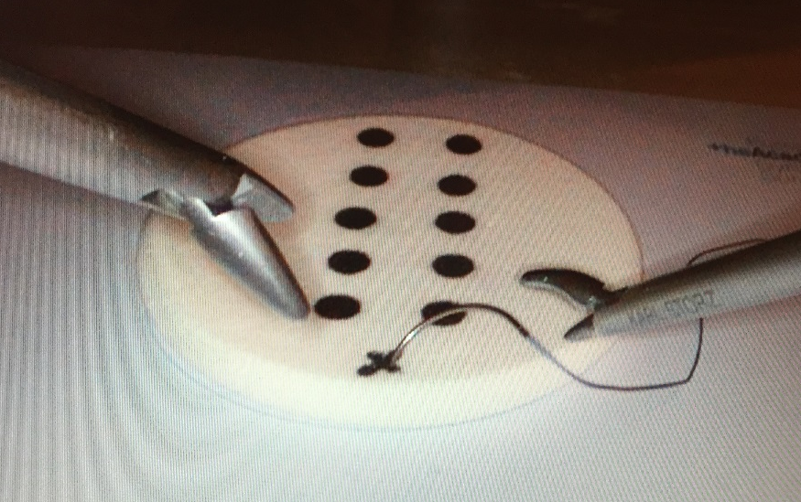
Starting Position
SUTT1 Exercise
In view:
Needle placed on the cross of the suturing pad, oriented at 3 o’clock
Tip of both needle holders

Slide 15
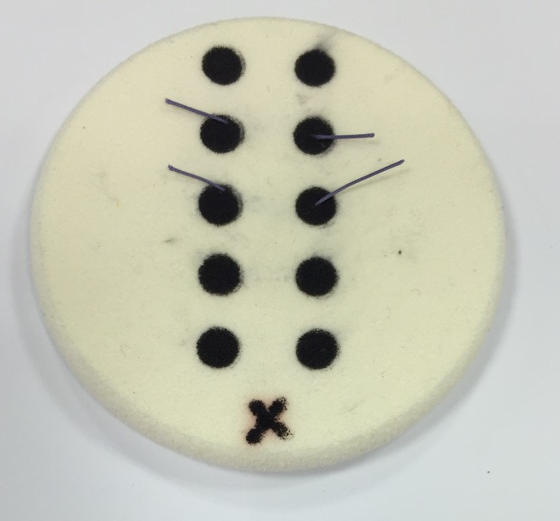
Procedure
SUTT1 Exercise
Perform 4 single stitches using your dominant hand and 1 stitch with an intra-corporeal knot
Pass the suture by entering and exiting within the black dots
Leave enough thread in the pad for evaluation
Cut off using laparoscopic scissors

Slide 16
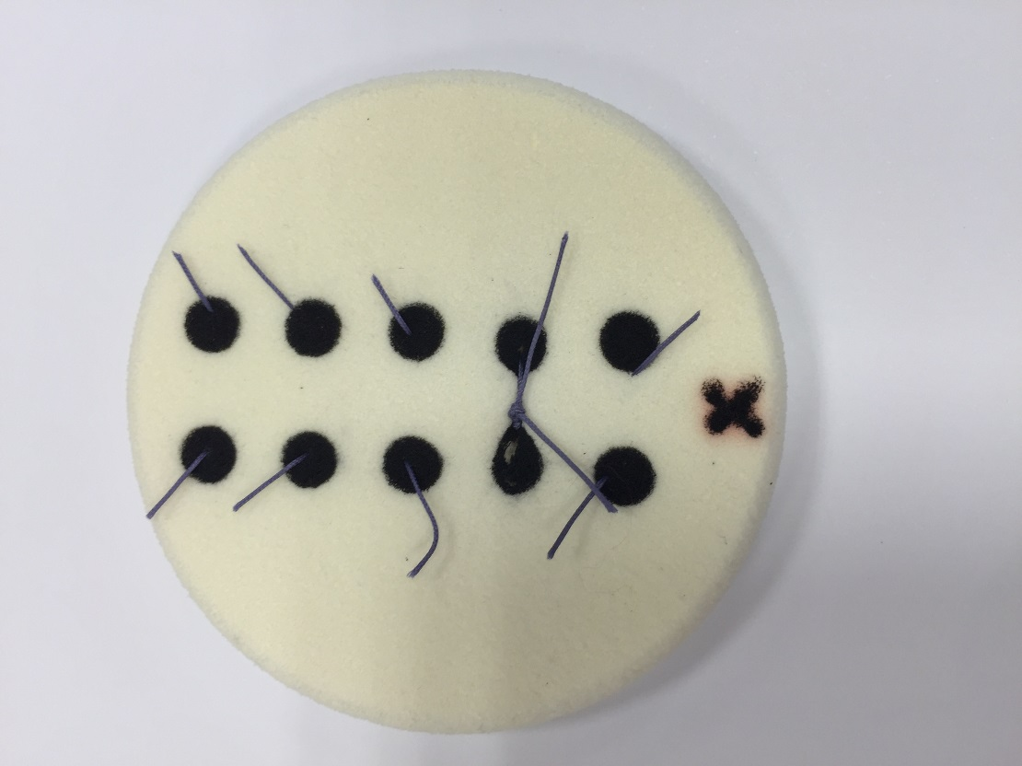
Procedure
SUTT1 Exercise
Use ONE single 20 cm
2-0 poly-filament V-20 ½ 26 mm for the whole exercise
One of the five stitches, of your choice, must be secured and completed with an intra-corporeal surgical knot, i.e. double throw and two locking sequences
The exercise is timed until both ends of the thread are released at the end of the stitching or knotting movements.

Slide 17
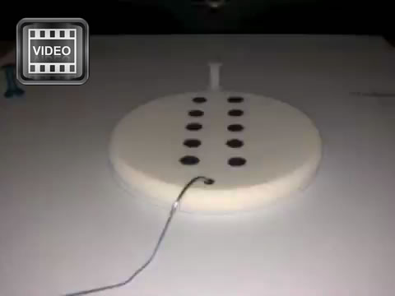
SUTT1 Exercise

Slide 18
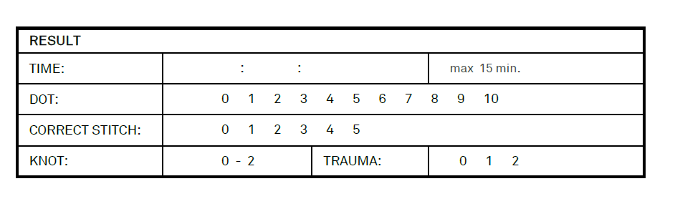
Scoring
SUTT1 Exercise
Maximum time of the exercise = 15 minutes
Exercise finished within 15 minutes:
write down the time mm:ss:hh
If not finished within 15 minutes:
write down 15:00:00
QUALITY will be checked afterwards – leave threads on pad!

Slide 19
SUTT2 Exercises

Slide 20
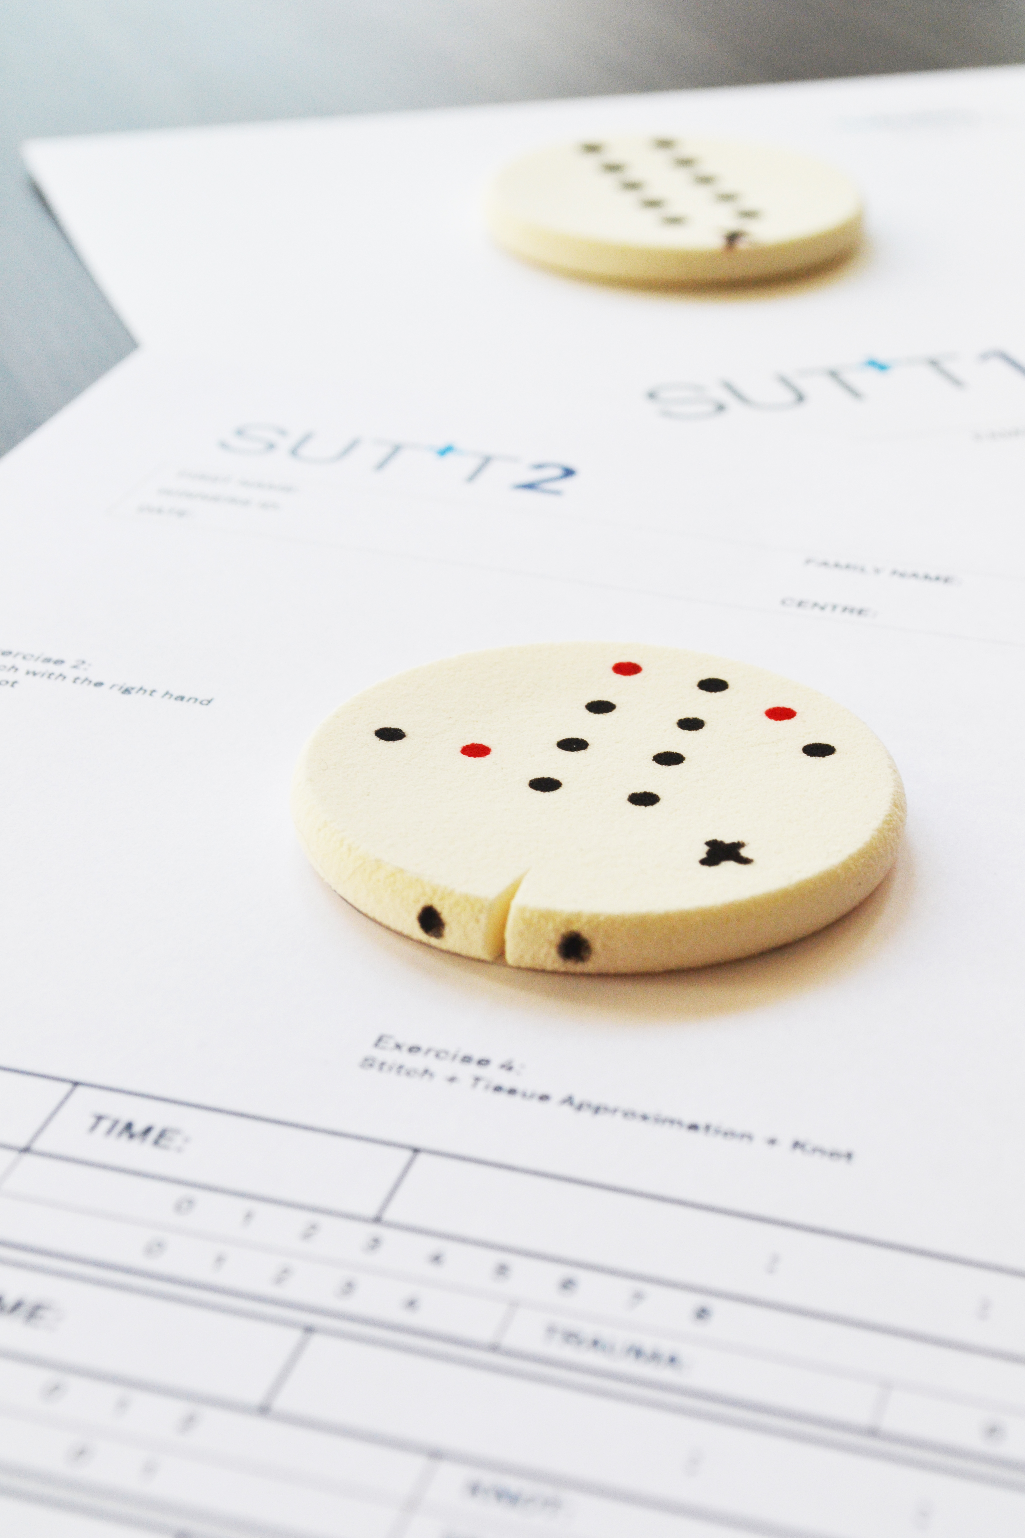
Aim
SUTT2 Exercises
Measure the ability of fine and complex motor skills by performing correct stitches and intra-corporeal knots.

Slide 21
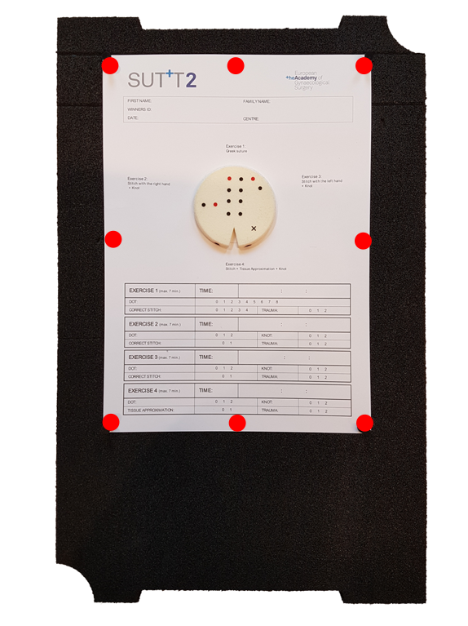
Setup
SUTT2 Exercises
Align the top of the SUTT2 paper with the first line from the top on the SUTT Foam Base
Securely attach the paper with 8 pins to the SUTT Foam Base
Place the SUTT Foam Base inside the Pelvic Trainer

Slide 22
Port Position
SUTT2 Exercises
6
CAMERA
is introduced in the frontal middle port (position 1)
NEEDLE HOLDERS
Your choice but position for each exercise must remain the same
TROCARS
are mandatory
Correct orientation of the pelvic trainer: port 1-3 are closer together than 3-6
5A
5B
4A
4B
3
2A
2B
1
CAMERA
Participant

Slide 23
4 Exercises
SUTT2 Exercises
Exercise 1
Stitching Greek Suture
Exercise 2
Stitching & knot tying with right hand
Exercise 3
Stitching & knot tying with left hand
Exercise 4
Stitching, tissue approximation and knot tying with dominant hand

Slide 24
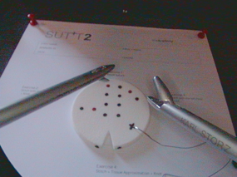
Starting Position
SUTT2 Exercises
In view:
Needle placed on the cross of the suturing pad, oriented at 3 o’clock
Introduce both needle holders

Slide 25
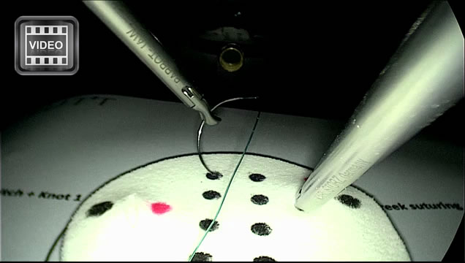
Ex 1: Greek Suture
SUTT2 Exercises

Slide 26
Procedure
Ex 1: Greek Suture
  15 cm 2-0 mono-filament V-20 ½ 26 mm.
  Start at red dot performing a left hand stitch
  Needle should be positioned correctly in dots
  Change hand after each stitch
  Be careful not to perform trauma
  Exercise timed until both ends of thread are released at end of the stitching movements.

Slide 27
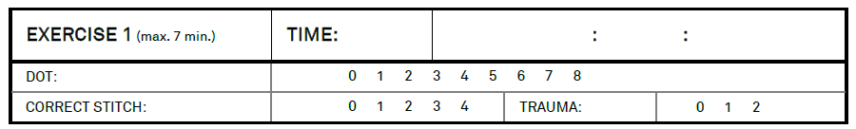
Scoring
Ex 1: Greek Suture
Maximum time of the exercise = 7 minutes
Exercise finished within 7 minutes:
write down the time mm:ss:hh
Exercise not finished within 7 minutes:
write down 7:00:00
QUALITY will be checked afterwards – leave threads on pad!

Slide 28
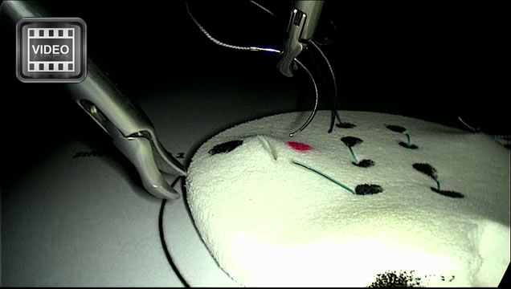
Ex 2: Right hand stitch & knot
SUTT2 Exercises

Slide 29
Procedure
Ex 2: Right hand stitch & knot
  Precise positioning of stitch on the predefined entry (red dot) & exit point (black dot)
  15 cm 2-0 mono-filament V-20 ½ 26 mm
  ONE intra-corporeal knot with flat knot and 2 locking sequences
  Exercise is timed until both ends of the thread are released at the end of the knotting movements
SUTT 2

Slide 30
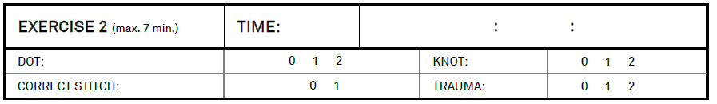
Scoring
Ex 2: Right hand stitch & knot
Maximum time of the exercise = 7 minutes
Exercise finished within 7 min:
write down the time mm:ss:hh
Exercise not finished within 7 minutes:
write down 7:00:00
QUALITY will be checked afterwards – leave threads on pad!

Slide 31
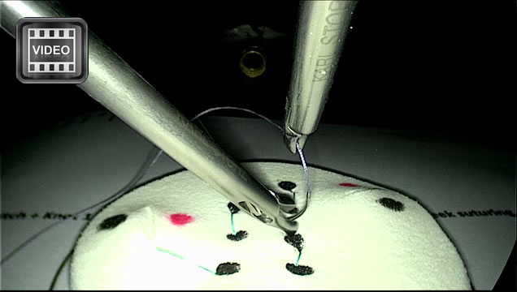
Ex 3: Left hand stitch & knot
SUTT2 Exercises

Slide 32
Procedure
Ex 3: Left hand stitch & knot
  Precise positioning of stitch on the predefined entry (red dot) and exit point (black dot)
  15 cm 2-0 poly-filament V-20 ½ 26 mm
  ONE intra-corporeal knot with flat knot and 2 locking sequences
  Exercise is timed until both ends of the thread are released at the end of the knotting movements

Slide 33
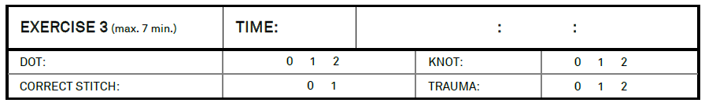
Scoring
Ex 3: Left hand stitch & knot
Maximum time of the exercise = 7 minutes
Exercise finished within 7 minutes:
write down the time mm:ss:hh
Exercise not finished within 7 minutes:
write down 7:00:00
QUALITY will be checked afterwards – leave threads on pad!

Slide 34
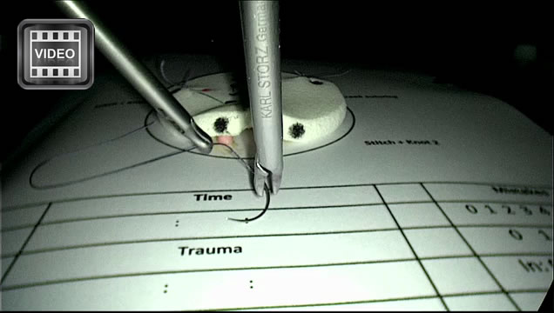
Ex 4: Stitching, tissue approximation & knot
SUTT2 Exercises

Slide 35
Procedure
Ex 4: Stitching, tissue approximation & knot
  Precise positioning of stitch on the predefined entry & exit point with 15 cm 2-0 poly-filament V-20 ½ 26 mm
  Correct approximation of tissue by performing one intra-corporeal flat knot with 2 locking sequences
  Free choice of stitching hand
  Exercise is timed until both ends of the thread are released at the end of the knotting movements

Slide 36
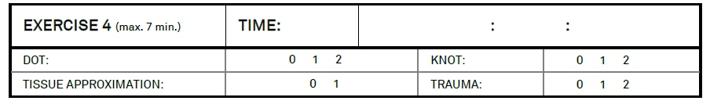
Scoring
Ex 4: Stitching, tissue approximation & knot
Maximum time of the exercise = 7 minutes
Exercise finished within 7 minutes:
write down the time mm:ss:hh
Exercise not finished within 7 minutes:
write down 7:00:00
QUALITY will be checked afterwards – leave threads on pad!

Slide 37
Questions?
info@europeanacademy.org

